Slide 1
Neobank Customer Churn & Engagement Analytics
End-to-End Data Analytics Project
Python | SQL Server | Power BI
Prepared by Jadesola Ogunkayode
Notes:
Speaker Notes:
Neobank Customer Churn & Engagement Analytics
Expand on the key points on this slide using examples from your project and dashboard.

Slide 2
Business Background & Problem
• Digital banks face increasing customer churn.
• Management needs visibility into high-risk customers.
• Engagement varies across subscription plans.
• Goal: support data-driven retention decisions.
Notes:
Speaker Notes:
Business Background & Problem
Expand on the key points on this slide using examples from your project and dashboard.

Slide 3
Project Objectives
• Identify churn drivers.
• Analyse customer engagement.
• Compare subscription plans.
• Deliver an executive dashboard with actionable insights.
Notes:
Speaker Notes:
Project Objectives
Expand on the key points on this slide using examples from your project and dashboard.

Slide 4
Project Workflow
Data Collection → Python → SQL Server → Power BI → Business Insights → Recommendations
Notes:
Speaker Notes:
Project Workflow
Expand on the key points on this slide using examples from your project and dashboard.

Slide 5
Data Preparation & Analysis
Python:
• Data cleaning
• Feature engineering
SQL Server:
• Business queries
• Aggregations
• Trend analysis
Notes:
Speaker Notes:
Data Preparation & Analysis
Expand on the key points on this slide using examples from your project and dashboard.

Slide 6
Power BI Solution
• Star schema data model
• DAX measures & KPIs
• Interactive slicers
• Executive dashboard
Notes:
Speaker Notes:
Power BI Solution
Expand on the key points on this slide using examples from your project and dashboard.

Slide 7
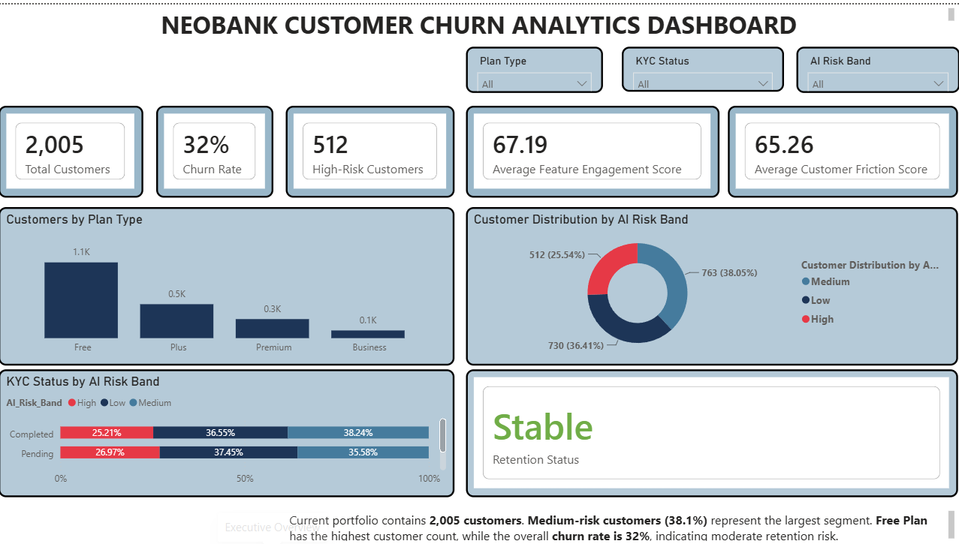
Executive Overview
Notes:
Speaker Notes:
Executive Overview
Expand on the key points on this slide using examples from your project and dashboard.

Slide 8
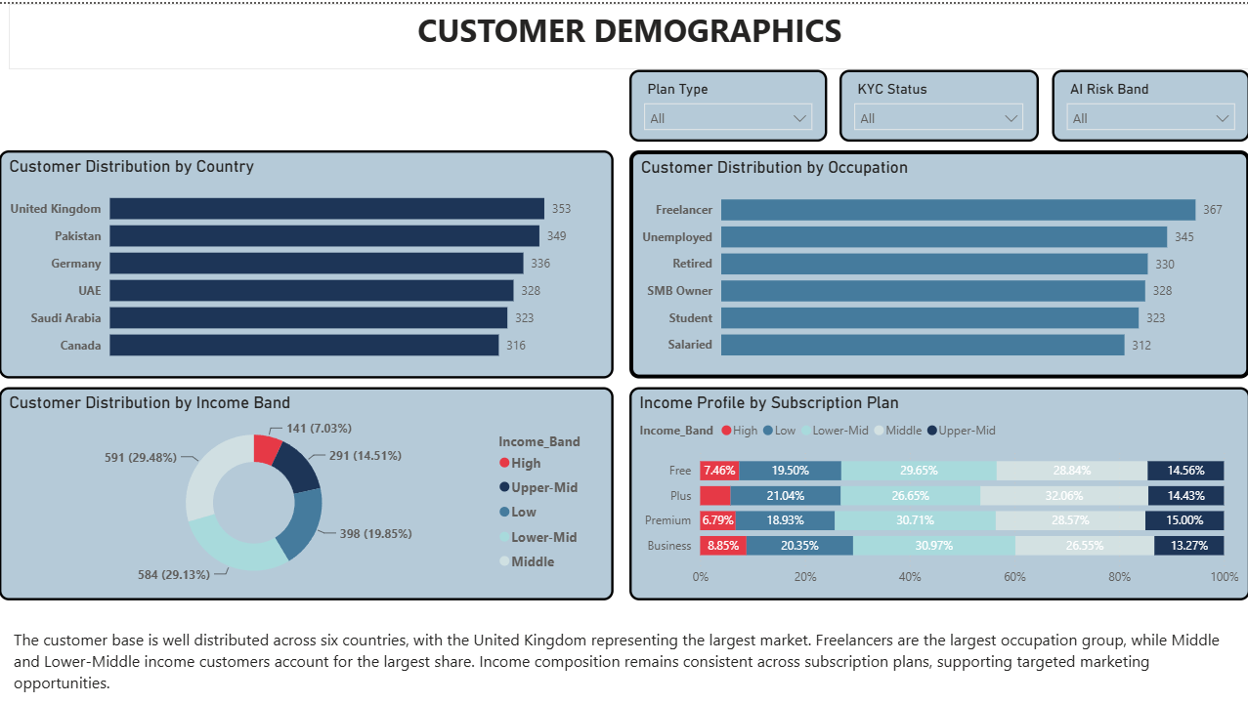
Customer Demographics
Notes:
Speaker Notes:
Customer Demographics
Expand on the key points on this slide using examples from your project and dashboard.

Slide 9
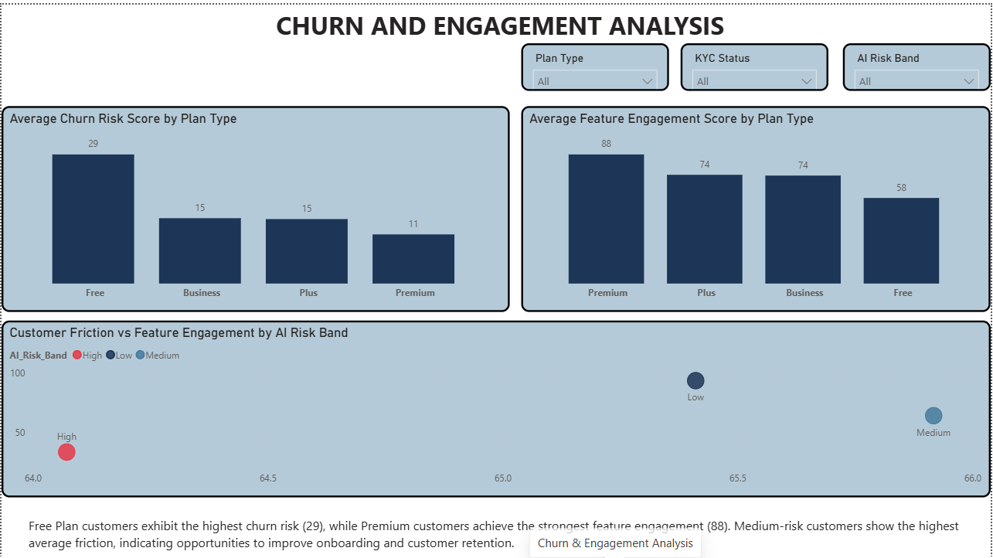
Churn & Engagement
Notes:
Speaker Notes:
Churn & Engagement
Expand on the key points on this slide using examples from your project and dashboard.

Slide 10
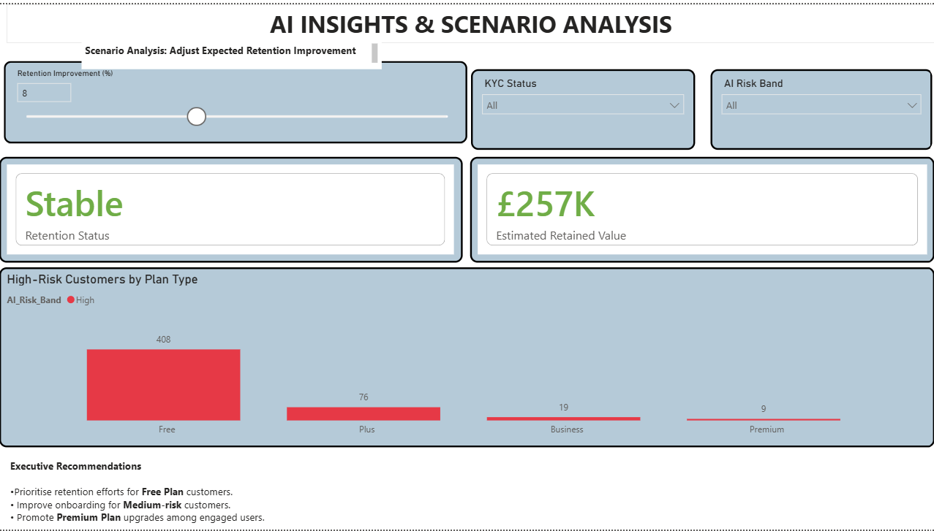
AI Insights & Scenario Analysis
Notes:
Speaker Notes:
AI Insights & Scenario Analysis
Expand on the key points on this slide using examples from your project and dashboard.

Slide 11
Business Recommendations
1. Improve Free Plan retention.
2. Target medium-risk customers early.
3. Increase feature adoption.
4. Personalise campaigns.
5. Monitor KPIs continuously with Power BI.
Notes:
Speaker Notes:
Business Recommendations
Expand on the key points on this slide using examples from your project and dashboard.

Slide 12
Conclusion & Questions
• End-to-end analytics using Python, SQL Server and Power BI.
• Delivered actionable business insights.
• Enabled data-driven decision making.
Thank you.
Questions?
Notes:
Speaker Notes:
Conclusion & Questions
Expand on the key points on this slide using examples from your project and dashboard.

